Slide 1
Course Name: Database Management System
Course Code: CS116
Dr. Praveen Kantha

Slide 2
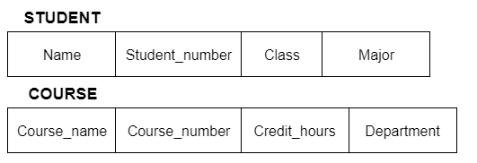
Schemas:
Schema is the overall description of the database.
The basic structure of how the data will be stored in the database.
For Example:
type CUSTOMER=record
CUSTOMER_ID:integer
CUSTOMER_Name:String
CUSTOMER_ADD:String

Slide 3
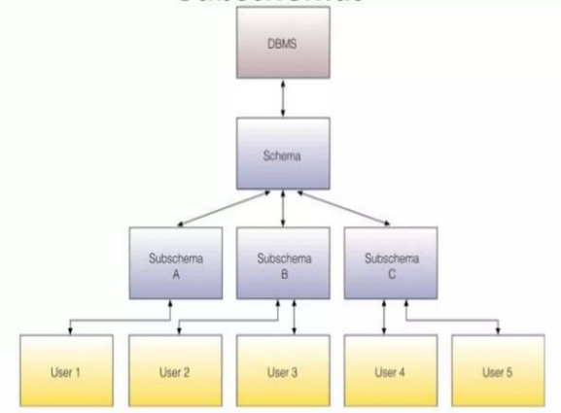
Sub Schemas:
It is the subset of the schema and inherits the same property that a schema has.
It gives the users a window through which he/she can view only that part of the database which he want.

Slide 4
Instances:
The collection of the data stored in the database at a particular moment is called an instance of a database.
For example:
Let’s say we have a single table student in the database, Today the table has 100 records, so today the instance of the database has 100 records.
Let’s say we are going to add another 100 records in this table by tomorrow so the instance of the database tomorrow will have 200 records in a table.

Slide 5
Schema Architecture:
The three-schema model consisting conceptual level, an external level, and internal or physical level was first introduced by Charles Bachman in 1975.
The motive of studying database architecture is to provide an abstract view.
Abstract view means that the system hides details on how the data is stored & and maintained in data base.

Slide 6
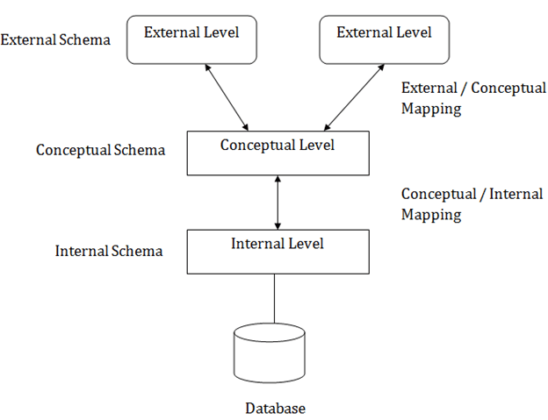
Schema Architecture:
The abstraction can be achieved by the help of 3-levels >
Internal (Physical) Level
Conceptual (Logical) Level
External (View) Level

Slide 7
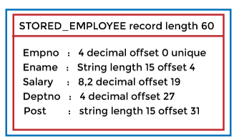
Internal (Physical) Level:
The internal level has an internal schema that describes the physical storage structure of the database.
The internal schema is also known as a physical schema.
It gives complete details of data storage access paths, various record types, physical sequence of records etc.
This is the low-level representation of the entire database in detail.

Slide 8
b) Conceptual (Logical) Level
The conceptual schema describes the design of a database at the conceptual level. The conceptual level is also known as the logical level.
The conceptual schema describes the structure of the whole database.
The conceptual level describes what data are to be stored in the database and also describes what relationship exists among those data.
In the conceptual level, internal details such as an implementation of the data structure are hidden.

Slide 9
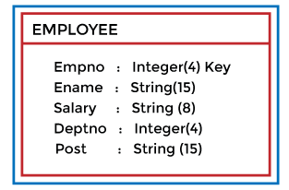
b) Conceptual (Logical) Level
Programmers and database administrators work at this level.

Slide 10
c) External (View) Level
The external level is concerned with individual users.
At the external level, a database contains several schemas that are sometimes called subschema. The subschema is used to describe the different views of the database.
An external schema is also known as a view schema.
Each view schema describes the database part that a particular user group is interested in and hides the remaining database from that user group.

Slide 11
Different Mapping in Three Levels:
1) The Conceptual / Internal Mapping:
The Conceptual/ Internal Mapping lies between the conceptual level and the internal level.
It specifies how the data is retrieved from physical storage and shown at the conceptual level and vice-versa.
It also specifies how the conceptual record and field are represented at the internal level.

Slide 12
Different Mapping in Three Levels:
1) The External / Conceptual Mapping:
The External/Conceptual Mapping lies between the external level and the conceptual level.
Its role is to define the correspondence between a particular external and the conceptual view.
It also specifies how the data is retrieved from the conceptual level and shown at the external level because, at an external level, some part of the database is hidden from a particular user.

